Slide 1
Meeting with the Embassy of Italy
October 27, 2017

Slide 2

WPK is a hundred percent Kazakhstan company with 15 years of experience in providing immigration services:
ABOUT WPK
Visa support to Kazakhstan
Work permits in Kazakhstan
Passport registration
Work with investors
Schengen, US, UK visas
Citizenship by investment
Apostille and legalization of documents
Court assistance
Seminars and trainings
WPK is permanently presented in Astana, Almaty, Atyrau, Aktau and Aksai.

Slide 3

OUR CLIENTS
WE ARE TRUSTED

Slide 4

WORK PERMITS & VISAS
FOR FOREIGN EXPATS

Slide 5
QUOTA
QUOTA REQUEST | RED FLAGS
Deadline | Till 31st July
Region of submission | In each region where work performed
Quota allocation | By type of business
Authority | Committee

Slide 6
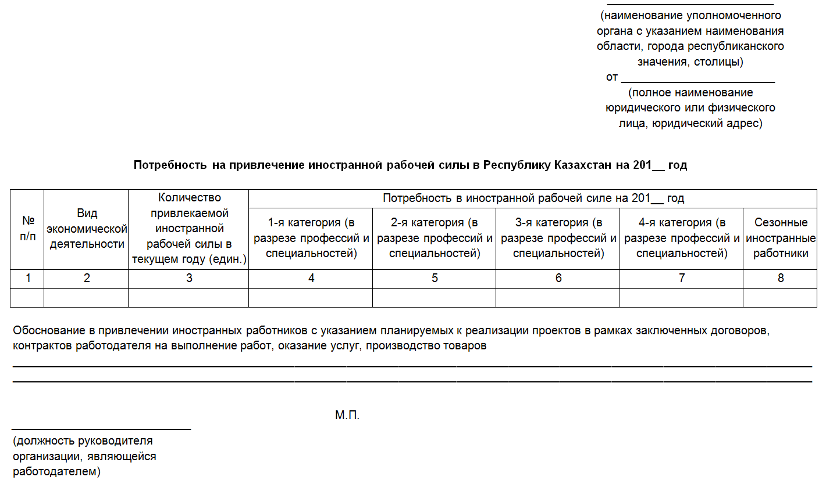
QUOTA REQUEST TEMPLATE

Slide 7
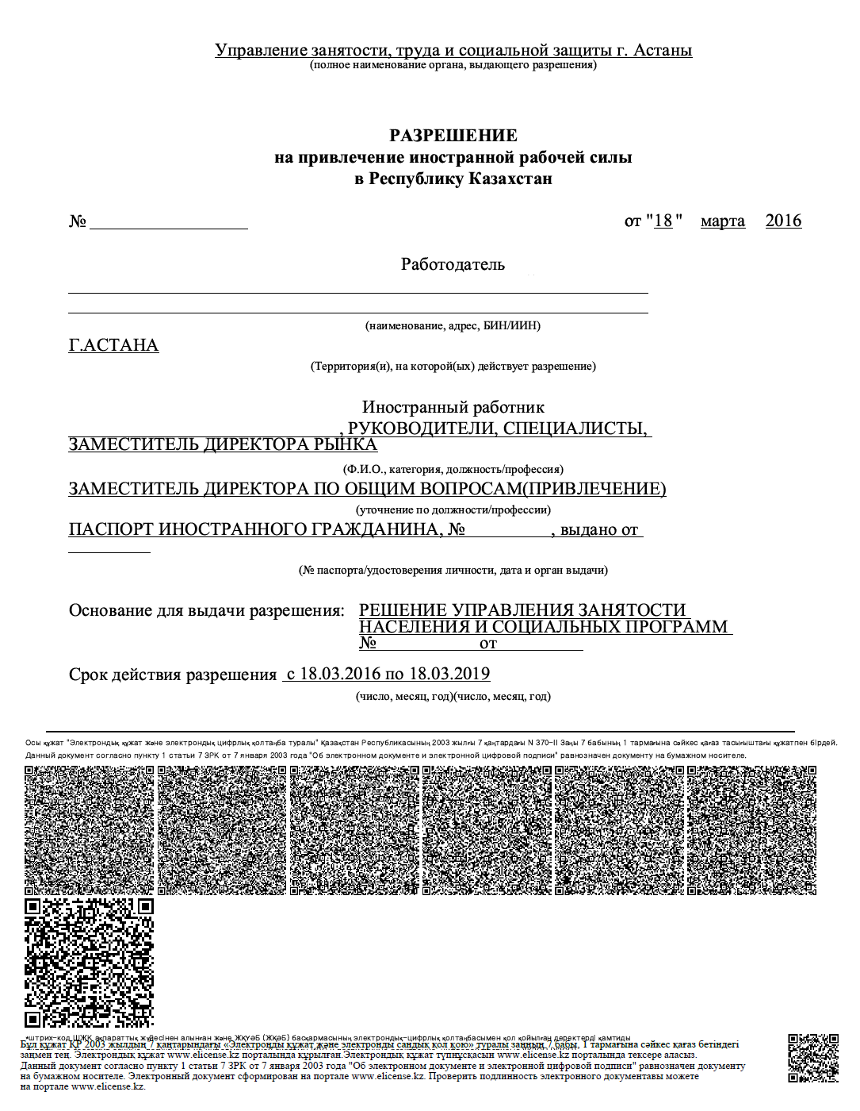
WORK PERMIT TEMPLATE

Slide 8
EXEMPTION
WORK PERMIT IS NOT REQUIRED FOR
1 | Citizens of Russia, Belarus, Armenia, Kyrgyzstan (EEU) | 5 | Sportsmen, actors, teachers
2 | Chief executives of the foreign Branches and Representative offices | 6 | Participants of special economic zones
3 | Investors | 7 | Foreigners applying for self-employment
4 | Crew members of sea vessels, air transport | 8 | Foreigners with resident permits

Slide 9
LOCAL CONTENT
CATEGORY | DESCRIPTION | RATIO*, %
1 category | Chief executives and deputies | 70/30
2 category | Heads of structural divisions
3 category | Specialists | 90/10
4 category | Qualified workers
*except citizens of EEU

Slide 10
EXEMPTION
Local content is not required for:
Small business entities
Government entities and organizations
Foreigners applying for self-employment
Branches, representative offices with less than 30 employees

Slide 11
CHARGE RATES 2017, KZT
Type of business | 1 category | 2 category | 3 category | 4 category
Oil & gas | 349 426 | 403 882 | 458 338 | 510 525
Transport | 310 853 | 358 502 | 406 151 | 453 800
Construction | 387 999 | 449 262 | 508 256 | 567 250
Provision of other type of services | 349 426 | 403 882 | 458 338 | 510 525

Slide 12
WORK PERMIT VALIDITY
CATEGORY | WORK PERMIT VALIDITY
1 category | 1 year extension for 1 year, without limitation*
2 category | 1 year extension for 1 year, but not more than 3 times*
3 category
4 category | 1 year without extension
*extension not later than 1 month

Slide 13

DIPLOMA

Slide 14
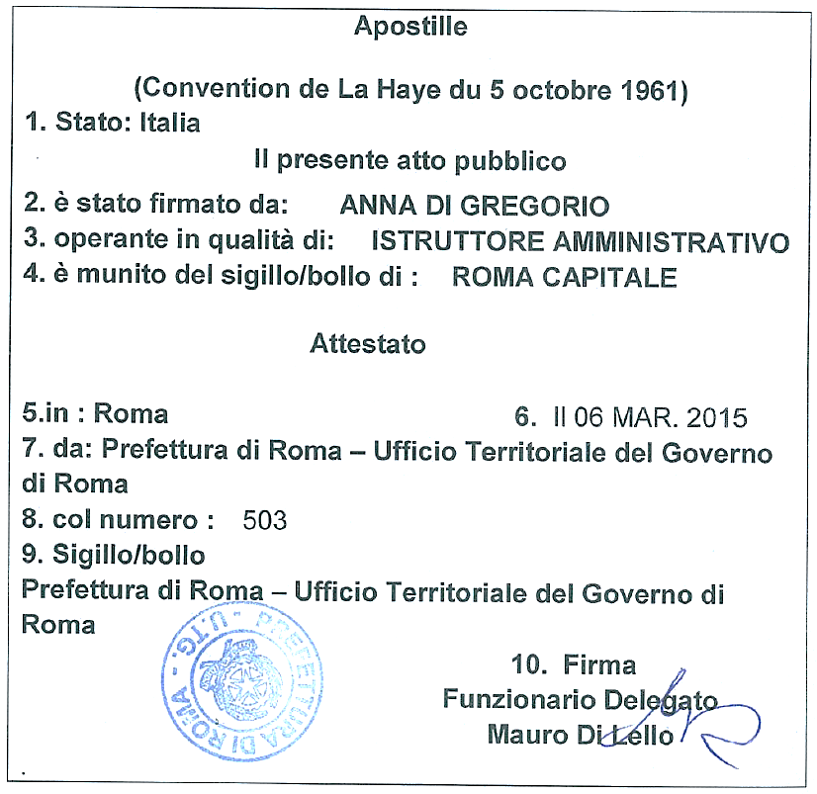
APOSTILLE

Slide 15
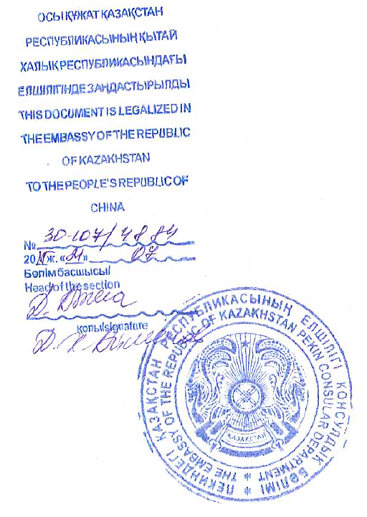
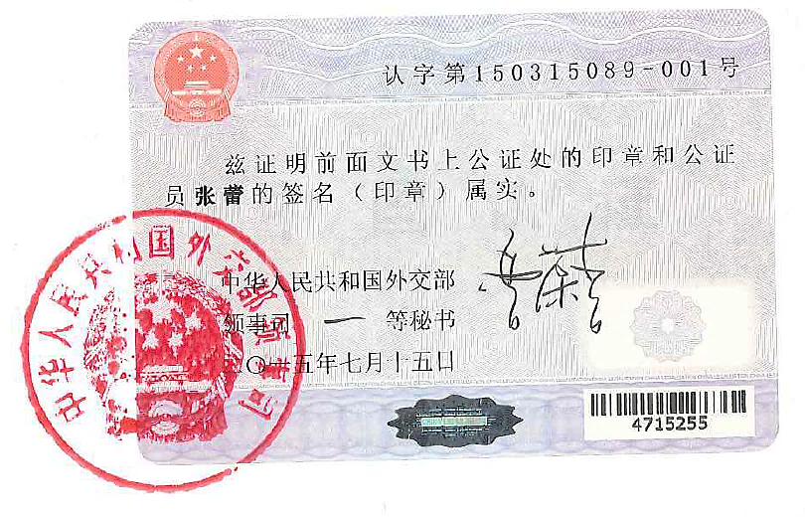
LEGALIZATION

Slide 16
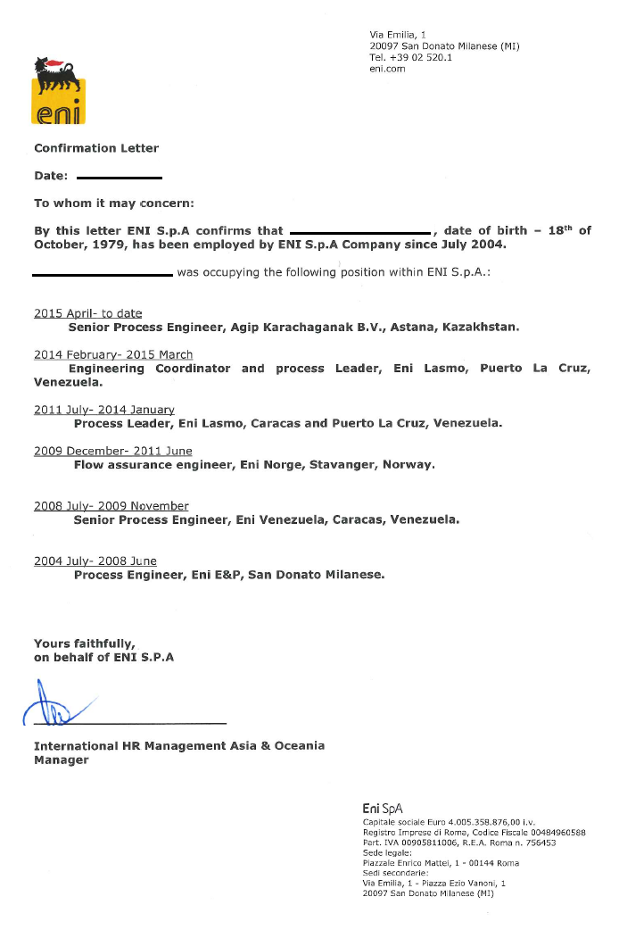
EXPERIENCE BACKGROUND

Slide 17

VISA TO
KAZAKHSTAN

Slide 18
MAIN POINTS
DESCRIPTION
Category of visa | A, B, C
Number of entries | 1-entry, Multiple-entry
Investor visa | A5
Business visa | B1, B2, B3
Work visa | C3

Slide 19
MAIN POINTS
PROCEDURE
Acceptance of documents | Migration service
Registration of the company in the database | Onсe a year
Submission of the invitation letter | In 2 weeks prior to arrival of the foreigner
Processing time | From 5 business days

Slide 20
MAIN POINTS
PROCEDURE | FEES, KZT
Approval of the invitation letters | 1 134
Issuance / extension of work visas in the RoK | 68 070
Exit visa | 1 134
Extension of stay under visa-free regime | 15 883

Slide 21

CATEGORY
OF THE VISA

Slide 22
INVESTOR VISA
TYPE | PURPOSE OF VISIT | TERM OF VALIDITY | PERIOD OF STAY
А5 | Investment activity | 1-entry up to 90 days | for the duration of visa
 |  | multiple-entry up to 3 years | for the duration of visa

Slide 23
BUSINESS VISA
TYPE | PURPOSE OF VISIT | TERM OF VALIDITY | PERIOD OF STAY
B1 | Conferences, forums, concerts, cultural and other events Meetings, round tables, meetings of experts | 1-entry up to 90 days | up to 60 days

Slide 24
BUSINESS VISA
TYPE | PURPOSE OF VISIT | TERM OF VALIDITY | PERIOD OF STAY
B1 | Humanitarian assistance Lecturing and conducting classes Exchange programs (student, school) | 1-entry up to 90 days | up to 60 days
 |  | multiple-entry up to 1 year | not more than 60 days at each entry

Slide 25
BUSINESS VISA
TYPE | PURPOSE OF VISIT | TERM OF VALIDITY | PERIOD OF STAY
B2 | Installation and maintenance of the equipment Provision of the consulting and auditing services | 1-entry up to 90 days | up to 30 days
 |  | multiple-entry up to 180 days | up to 90 days

Slide 26
BUSINESS VISA
TYPE | PURPOSE OF VISIT | TERM OF VALIDITY | PERIOD OF STAY
B3 | Negotiations, conclusion of the agreements For shareholders and board of the directors | 1-entry up to 90 days | up to 30 days
 |  | multiple-entry up to 1 year | not more than 30 days at each entry

Slide 27
WORK VISA
TYPE | PURPOSE OF VISIT | TERM OF VALIDITY | PERIOD OF STAY
C3 | Employment | multiple-entry up to 3 years or till work permit validity | for the duration of visa

Slide 28

VISA WAIVER PROGRAM

Slide 29
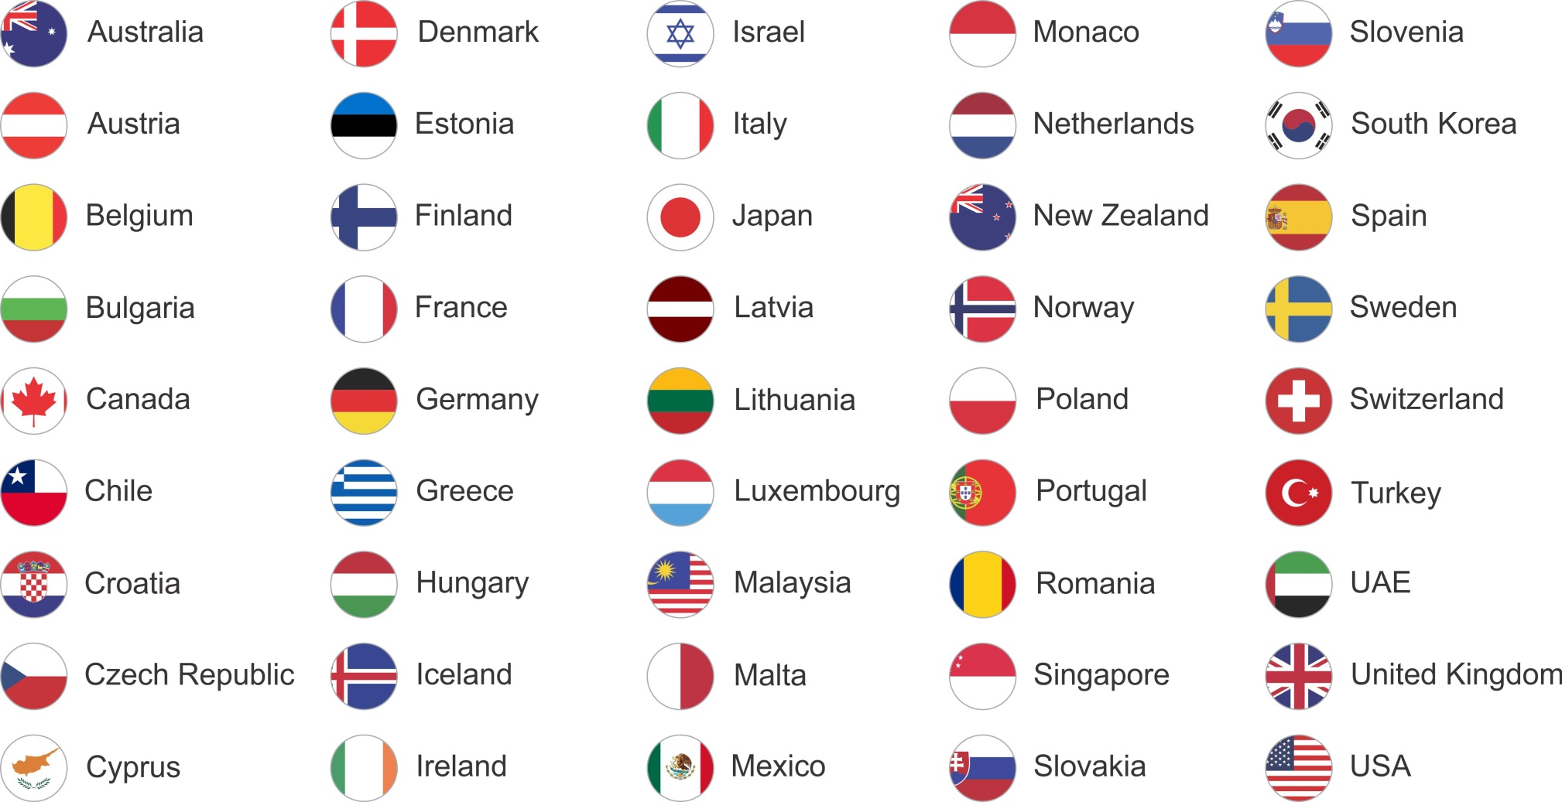
VISA-FREE REGIME
45
COUNTRIES
VISA-FREE REGIME

Slide 30
VISA-FREE REGIME
№ | DESCRIPTION | CONDITIONS
1 | Period of stay | Up to 30 days at each entry
2 | Purpose of visit | Business, tourism, private
3 | Order of registration | Without registration for up to 30 days (2 stamps in the migration card)
4 | Extension of stay (issuance of business visa) | 1-entry visa for up to 30 days
5 | Issuance of work visa | If work permit available

Slide 31

PASSPORT REGISTRATION

Slide 32
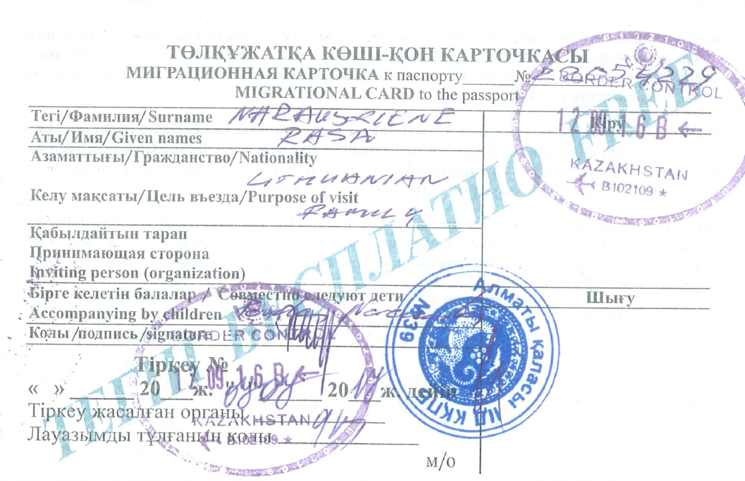

MIGRATION CARD

Slide 33
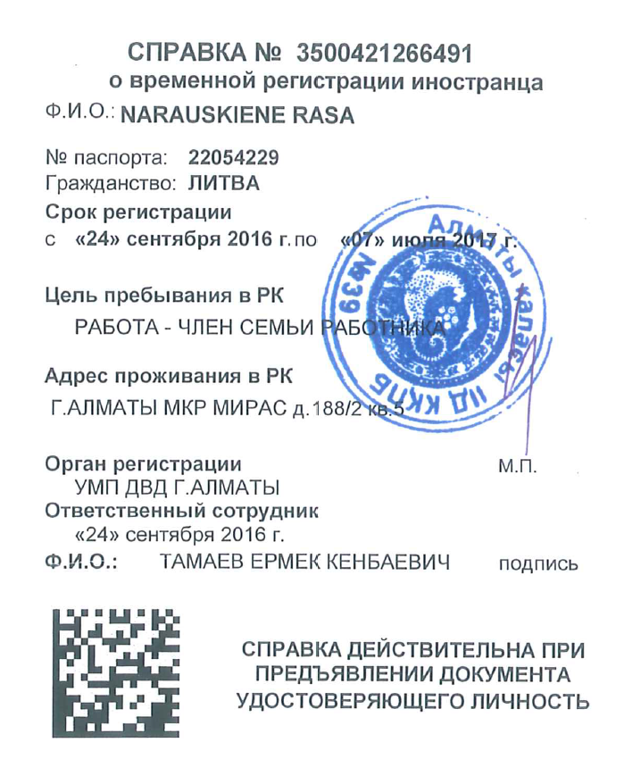

PASSPORT REGISTRATION
MIGRATION POLICE
Passport registration is required
within 5 calendar days

Slide 34
EXEMPTION
Passport registration is not required for:
Citizens of 45 countries of visa-free regime
Migration card is not required for:
Holders of A5 investor visa
Children under 16 years
Holders diplomatic, service passports

Slide 35


THANK YOU

